Slide 1


IPASP-PR – Instituto de Pesquisa Aplicada em Segurança Pública do Paraná: Inteligência Artificial e Software Livre para o Combate Eficaz ao Crime via Identificação e Classificação de Veículos
Vision, Robotics and Imaging Laboratory
IPASP-PR
Research Line V
Study and implementation of techniques for hierarchical consistency, confidence calibration and VLM.
Students: Renan A. N. G. Escribano (PhD candidate), Felipe T. Peruci (Master’s student)
Advisor: Prof. PhD. Luiz E. S. de Oliveira
14/08/2026

Slide 2
General Objective
Develop and evaluate post-hoc mechanisms that make hierarchical vehicle recognition simultaneously consistent and probabilistically reliable, while investigating how the adaptation of vision-language models affects this reliability regime.

Slide 3
Three heads, one decision
UFPR-VeSV (Lima et al., 2025) — 24,945 images · 16,297 vehicles · 10 official folds;
Type (14) × make (26) × model (136) = 49,504;
Possible tuples Only 225 ever occur — 0.45% of the space.

Slide 4
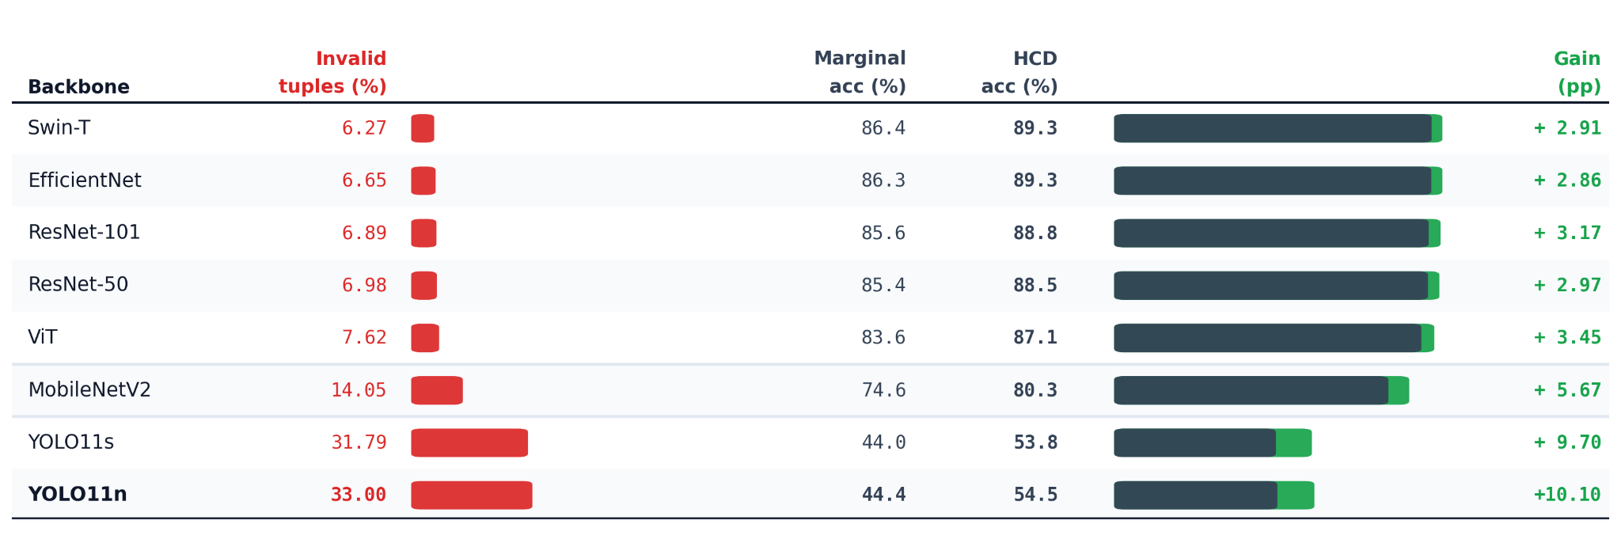
Hierarchically Consistent Decoding
Figure 1: Authors, 2026

Slide 5
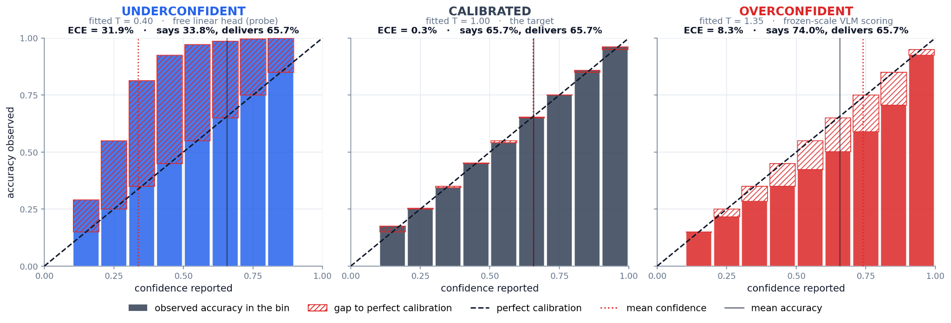
What’s Miscalibration?
Figure 2: Adaptado de Guo et al., 2017

Slide 6
Reliability does not compose
Three calibrated heads do not make a calibrated tuple.
Temperature scaling makes it worse, not better. Applied per head, it reverses the sign of the joint confidence gap, the system goes from overconfident to underconfident without ever modelling the joint event.
Aggregate ECE hides the disparity that matters. EfficientNet make: 7.1% ECE under infrared vs 1.5% in daylight.
And a single global temperature cannot fix it.

Slide 7
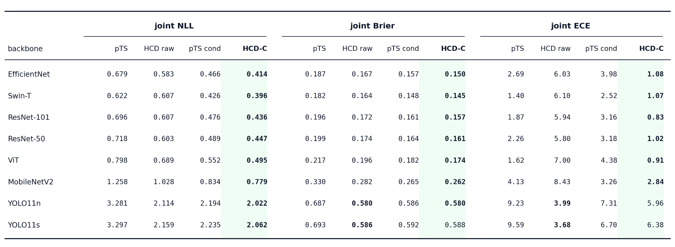
Hierarchically Consistent Decoding Calibration (HCD-C)
Figure 3: Authors, 2026

Slide 8
What HCD does not solve
Closed-world catalog. A semantically valid but never-observed tuple is rejected by construction.
One benchmark. Every result is on UFPR-VeSV. External validity is unestablished.

Slide 9
Visual Language Models for Zero-Shot
Two frozen encoders, one shared embedding space
Image encoder f: maps an image x to an L2-normalized embedding
z = f(x)
Text encoder g: maps each class name to a prototype t_{k}, constructed using a fixed prompt ensemble.
Classification without a trained classifier
l_{k}(x) = (z, t_{k}) / tau₀
The class set is defined at inference time by providing K text labels.

Slide 10
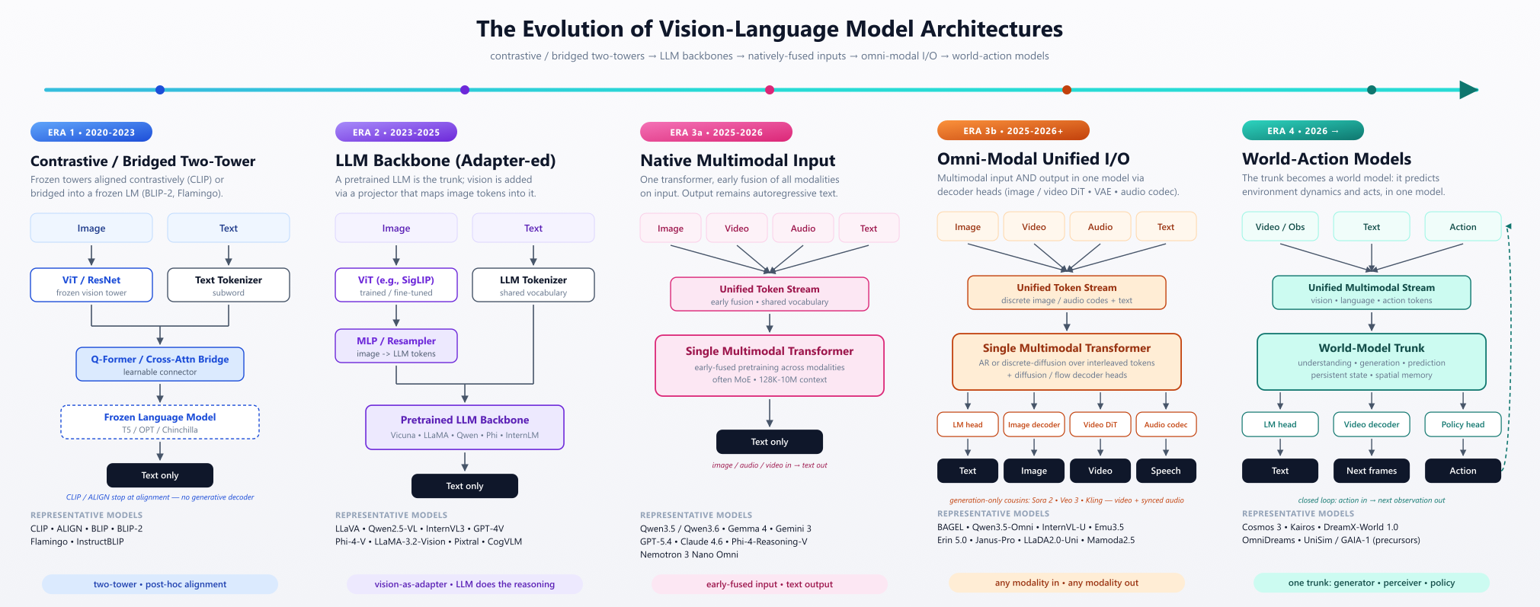
Visual Language Models Architectures
Figure 4: Li et al., 2025

Slide 11
Preliminary results with VLM
PE-Core-L/14-336px (Meta SOTA Model) + LoRA single-task
Type - prompt template:
"a photo of a {}."
Make - prompt template:
"a photo of a {} vehicle."
Model - prompt template:
"a photo of a {} car."

Slide 12
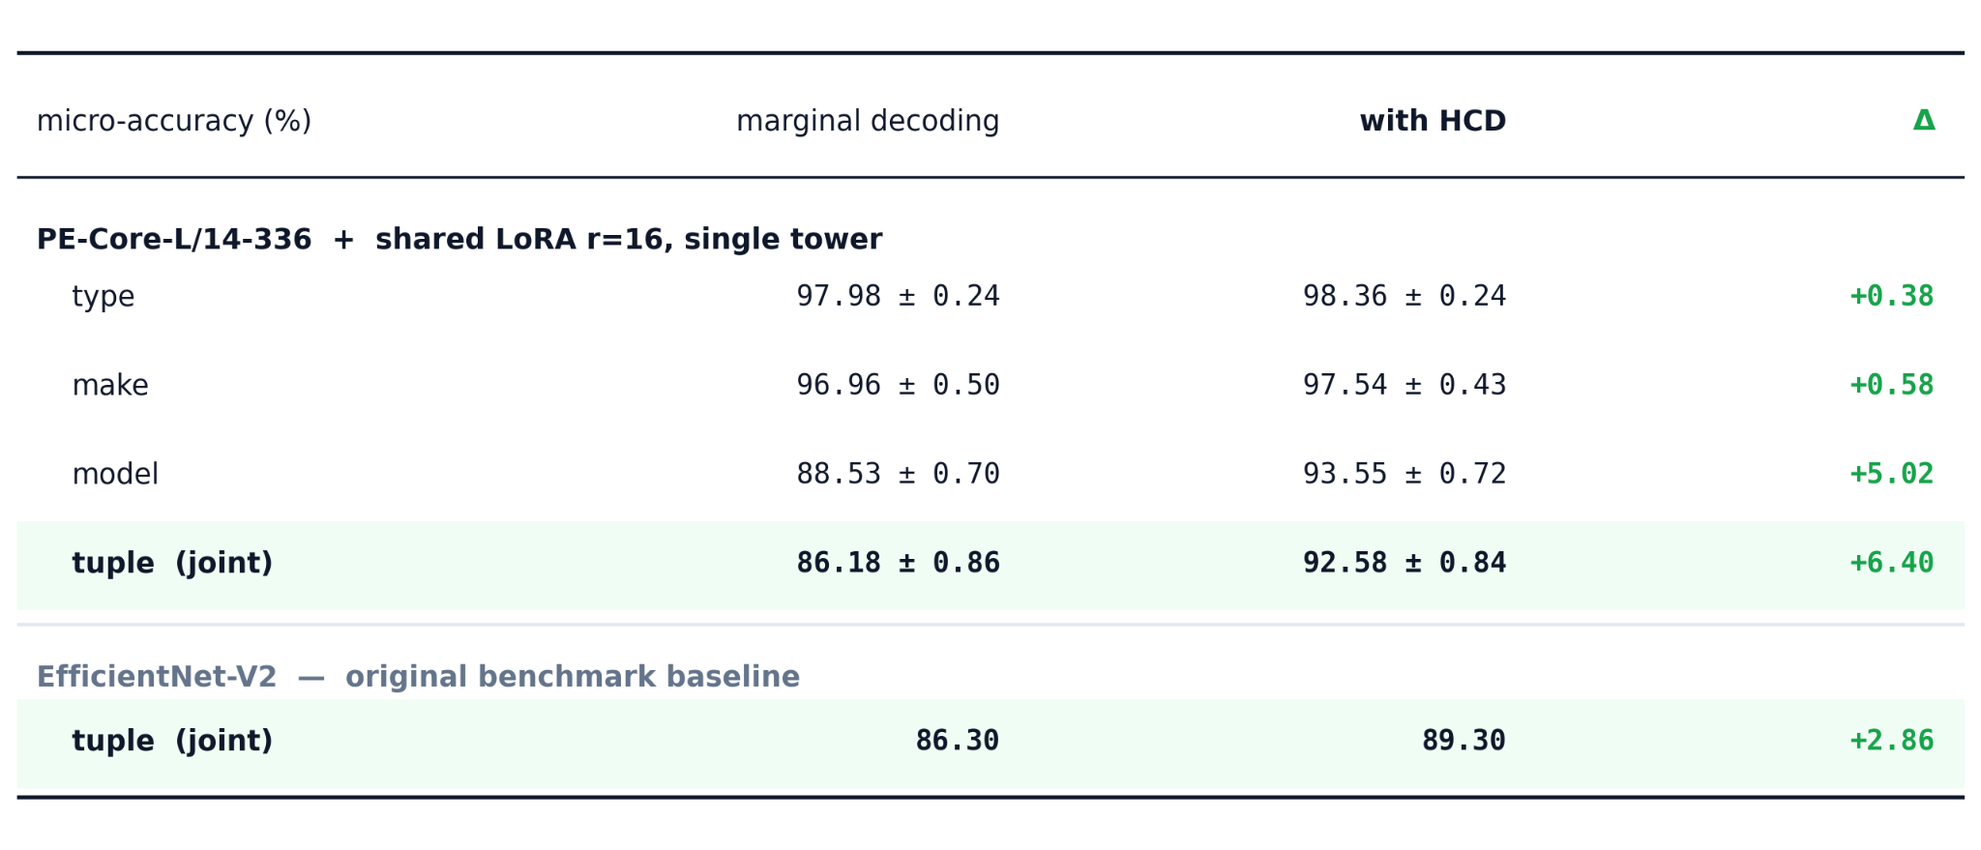
Preliminary results with VLM
Figure 5: Authors, 2026

Slide 13
Model architecture testing
Test how the model’s architecture affect its performance. There is a lot of open-source models to choose from, which gives better performance to ours tasks?
Name | Year | Architecture | Size
CLIP | 2021 | Encoder-Decoder | 63M - 355M
LLaVA-1.5 | 2023 | Decoder-only | 7B
InstructBLIP | 2023 | Encoder-Decoder | 7B
DeepSeek-VL2 | 2024 | Decoder-only | 3B
Qwen3 | 2025 | Decoder-only | 2B, 4B, 8B
SmolVLM | 2025 | Decoder-only | 256M, 500M, 2.2B
Gemma 4 | 2026 | Decoder-only | E2B (5B), 12B, 26B (A4B)
LFM2.5-VL | 2026 | Liquid Foundation Model | 450M, 1.6B
DiffusionGemma | 2026 | Diffusion Model | 26B (A4B)
Qwen3.5 | 2026 | Unified VL (early fusion) | 0.8B, 2B, 9B
Qwen3.6 | 2026 | MoE | 27B, 35B (A3B)

Slide 14
Tuning and post-tuning calibration in VLM
The literature cannot settle it. Adaptation is known to miscalibrate CLIP through logit-range inflation (Murugesan et al., 2024), and temperature fitted on base classes does not transfer to new ones (Wang et al., 2024).
Adaptation moves the very object the calibrator is fitted to. The scoring geometry is logit_scale · cosine. Every post-hoc calibrator is a map fitted on that geometry and LoRA optimises it directly.

Slide 15
Tuning and post-tuning calibration in VLM
The damage is not uniform and we measured it. Fine-tuning widens the infrared↔daylight gap by up to +9.8 pp of ECE. Sharpening the representation on the majority domain makes IR relatively more out-of-distribution. 21.5% of the benchmark is infrared. The average improves while the subgroup that matters degrades.

Slide 16
References
[1] Lima, G. E., Nascimento, V., Santos, E., Nascimento Jr., E., Laroca, R., Menotti, D. Toward Unified Fine-Grained Vehicle Classification and Automatic License Plate Recognition. JBCS, 32(1):783–799, 2026.
[2] Bolya, D. et al. Perception Encoder: The Best Visual Embeddings Are Not at the Output of the Network. arXiv:2504.13181, 2025.
[3] Hu, E. J. et al. LoRA: Low-Rank Adaptation of Large Language Models. ICLR, 2022.
[4] Guo, C., Pleiss, G., Sun, Y., Weinberger, K. Q. On Calibration of Modern Neural Networks. ICML, PMLR 70:1321–1330, 2017.
[5] Murugesan, B., Silva-Rodríguez, J., Ben Ayed, I., Dolz, J. Robust Calibration of Large Vision-Language Adapters. ECCV, LNCS 15082:147–165, 2024.
[6] Wang, S. et al. Open-Vocabulary Calibration for Fine-tuned CLIP. ICML, PMLR 235:51734–51754, 2024.
[7] Zanella, M., Ben Ayed, I. Low-Rank Few-Shot Adaptation of Vision-Language Models. CVPRW, 2024.
[8] Li Z. et al. A survey of State of the Art Large Vision Language Models: Alignment, Benchmark, Evaluations and Challenges. arXiv:2501.02189, 2025.

